Slide 1

SQL Project Data Analytics GA ANR 2-21
Surya Mohapatra

Slide 2
CITIBIKE dataset
Collection of bike rental data from 2016 to 2019 in NYC
5 Tables were used in this analysis including yearly data of bike rentals from 2016 to 2019 and a reference table of the bike rental station including the number of bike docks.

Slide 3
DATA DICTIONARY
Column Name | Data Type | Description
start_time | timestamp | start time of bike use
stop_time | timestamp | end time of bike use
start_station_id | integer | starting station
end_station_id | integer | ending station
bike_id | integer | unique bike id
user_type | text | subscriber (member) or customer
birth_year | numeric | birth year
gender | integer | 0-not specified, 1-male, 2-female
station_id | integer | unique station id
lattitiude | numeric | lattitude
longitude | numeric | longitude
name | text | street adress for station
docks | integer | number of bikes held at station

Slide 4

FRAMING THE PROBLEM
Key insights that could provide value for the CITIBIKE business include:
What amount of bike rentals occur at different bike stations around the city?
Do subscribers or customers use the bike rental system more often?
What time of day do is the service most used and at what stations?
What duration are the bikes rented for and how does that differ between subscribers and customers?

Slide 5
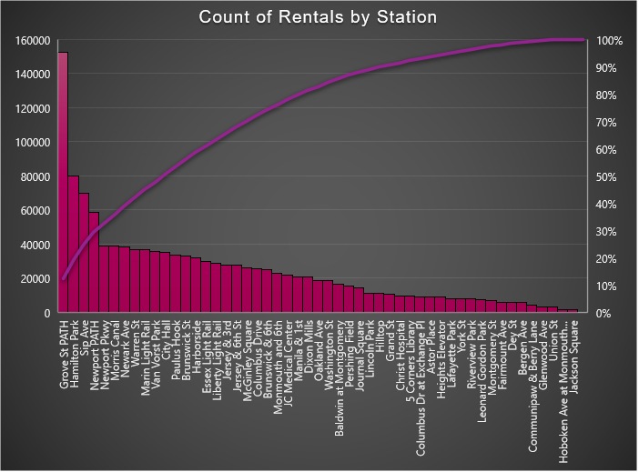
Analysis -Grove St Path dock station has the largest amount of rentals accounting for 10% of rentals from 2016-2019. -Hamilton Park, Sip Ave Newport Path had the 2nd,3rd,4th highest number of bike rentals. BUSINESS INSIGHT - More bike or docks could be provided at these stations.

Slide 6
ANALYSIS
-2019 had the highest number of rentals and a upward trend of bike rentals from 2016-2019
BUSINESS INSIGHT
-If this trend continues a larger number of bikes should be made available every year.
ANALYSIS
-The highest amount of rentals occur during the fall and summer months.
-August has the highest number of bike rentals followed by September and October.
BUSINESS INSIGHT
-More bikes can be introduced during these months to keep up with demand.

Slide 7
ANALYSIS -The largest number of bike rentals occur at Grove St Path during the evening hours followed by Hamilton Park in the morning and Newport path in the afternoon. BUSINESS INSIGHT - This data can be used to determine when additional bikes should be provided to customers at certain times of the day.

Slide 8
ANALYSIS - Mornings are the most popular time of day for bike rentals followed by afternoon and evenings. -The least amount of rentals are seen at night with only 3% of overall rentals.
BUSINESS INSIGHT
- More bikes should be made available during the morning, afternoon and evening and fewer during nighttime.

Slide 9
ANALYSIS
A long ride is greater than 30 minutes, medium between 10 and 30 minutes and short ride is less than 10 minutes.
Most bike rentals are under 10 minutes with significantly fewer that are medium rides and large rides.
BUSINESS INSIGHT
- Since longer rides are less frequent bikes can be designed for shorter use periods.
E-Bikes could be a good for shorter rides as it is less prone to low battery levels compared to longer rides.
ANALYSIS
Short rides are more popular for both subscribers and customers.
Medium and Long rides have more proportionate number of rentals between customers and subscribers.
BUSINESS INSIGHT
Non-subscribers or customers tend to have more medium rides than short rides.
Some bikes can be customized for longer trips for customers.

Slide 10
ANALYSIS
-Subscribers have significantly higher number of bike rentals of about 1.2 million while customers only have about 100 k rentals over a period of 4 years.
BUSINESS INSIGHT
-CITIBIKE should focus on increasing and maintaining their amount of subscribers
ANALYSIS
-The average rental duration for customers are about 17 -18 minutes whereas subscribers have an average ride duration of about 7-8 minutes.
BUSINESS INSIGHT
- Bikes for customers and subscribers can be customized for longer and shorter durations, respectively.

Slide 11
ANALYSIS
The stations that had the longest average ride times were Jackson Square, Lincoln Park and Riverview Park.
Further analysis could be done to determine if average ride times of customers can be correlated to stations that have longer average ride times.
BUSINESS INSIGHT
Since customers have significantly longer average ride times when compared to subscribers stations with longer ride times could feature more bikes geared towards customers.

Slide 12
SQL CODE TABLE JOIN
Table of all data from 2016 to 2019 of citibike ridership data were joined using unions since they all had identical columns
WITH t1_cte AS
(SELECT * FROM citibike_2016
UNION
SELECT * FROM citibike_2017
UNION
SELECT * FROM citibike_2018
UNION
SELECT * FROM citibike_2019)

Slide 13
SQL CODE EXAMPLE QUERY
Count of rentals grouped by station and time of day was queried using this code containing a cte, join, sub query and case features from sql.
WITH t1_cte AS (SELECT name, docks,start_time,
CASE
WHEN DATE_PART('hour',start_time)>=12 AND DATE_PART('hour',start_time)<18 THEN 'Afternoon'
WHEN DATE_PART('hour',start_time)>=6 AND DATE_PART('hour',start_time)<12 THEN 'Morning'
WHEN DATE_PART('hour',start_time)>=0 AND DATE_PART('hour',start_time)<6 THEN 'Night'
ELSE 'EVENING'
END AS time_of_day
FROM
(SELECT * FROM citibike_2016 UNION
SELECT * FROM citibike_2017 UNION
SELECT * FROM citibike_2018 UNION
SELECT * FROM citibike_2019 ) as temp
JOIN citibike_stations cbs
ON cbs.id=temp.start_station_id)
SELECT name,time_of_day, COUNT(*) as count_rental
FROM t1_cte
GROUP BY 1,2
ORDER BY 3 DESC

Slide 14

SUMMARY
CITIBIKE should focus on providing more bikes year b y year as number of bike rentals are steadily increasing.
Bike rental stations at certain times should be focused upon as more rentals occur at that time and place.
Customers have longer ride times when compared to subscribers and CITIBIKE could customize their services accordingly.
Fall and Summer months have larger number of bike rentals and could be utilized to provide more revenue as demand is high.

